Slide 1

Finca 4 Gatos Locos
1
An Exclusive Vineyard Opportunity
Plots 66 & 103
in Tupungato Winelands

Slide 2
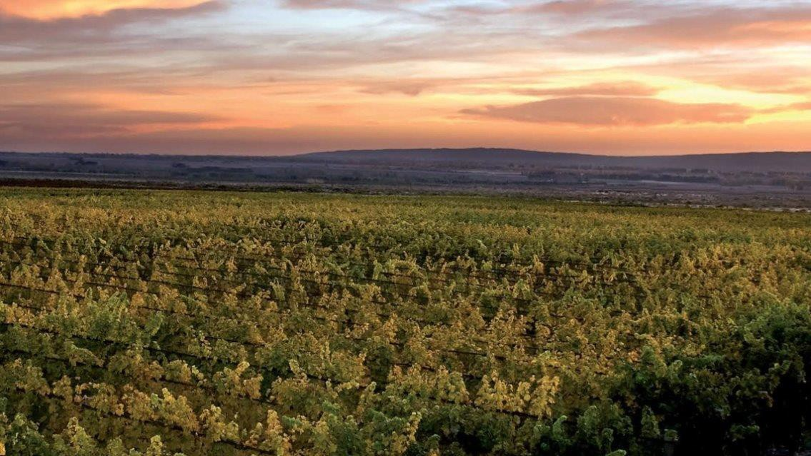
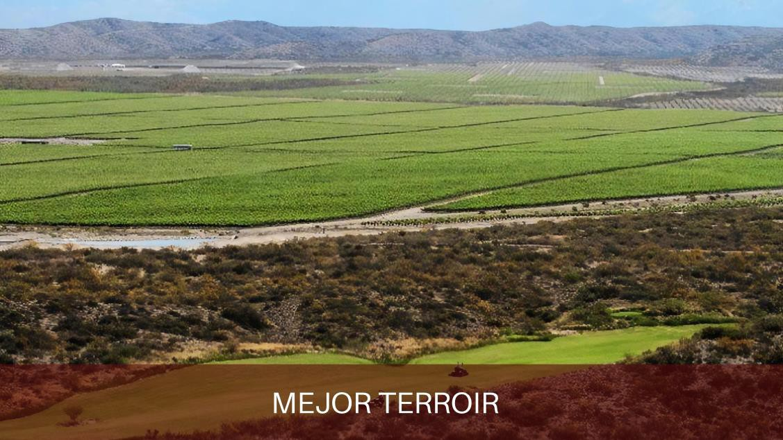
Located within Tupungato Winelands, at foothills of the Sierra del Jaboncillo, in Gualtallary, Mendoza
2
Altitude: 1350 meters
- Distance from Tupungato: 11.4 km
Distance from Mendoza: 86.9 km
Drip irrigation system
Underground irrigation rights
Connected to Tupungato Winelands' main irrigation system
Organic certification through Letis
Planting density: 2m x 1m

Slide 3
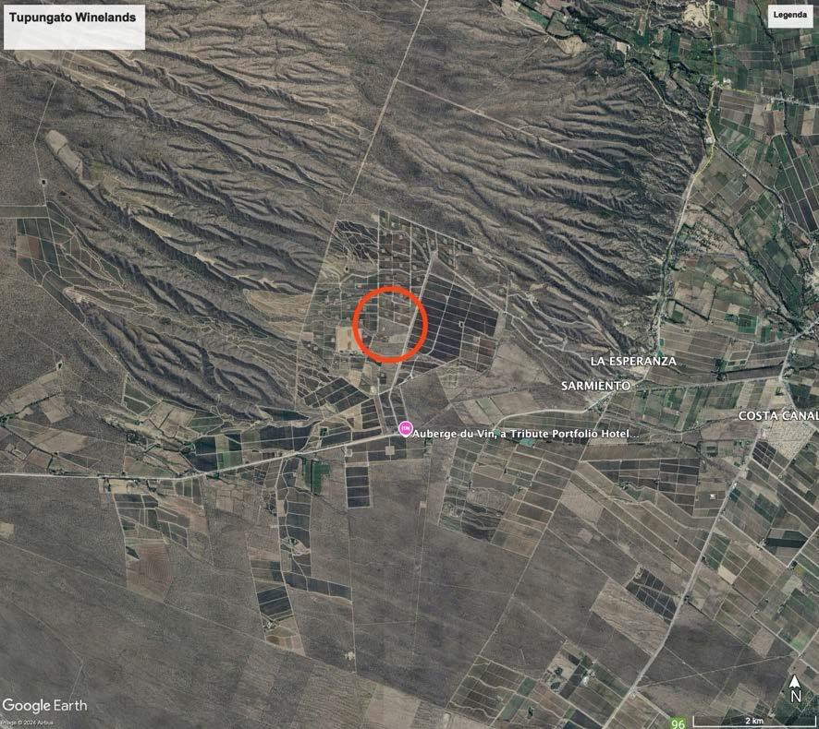
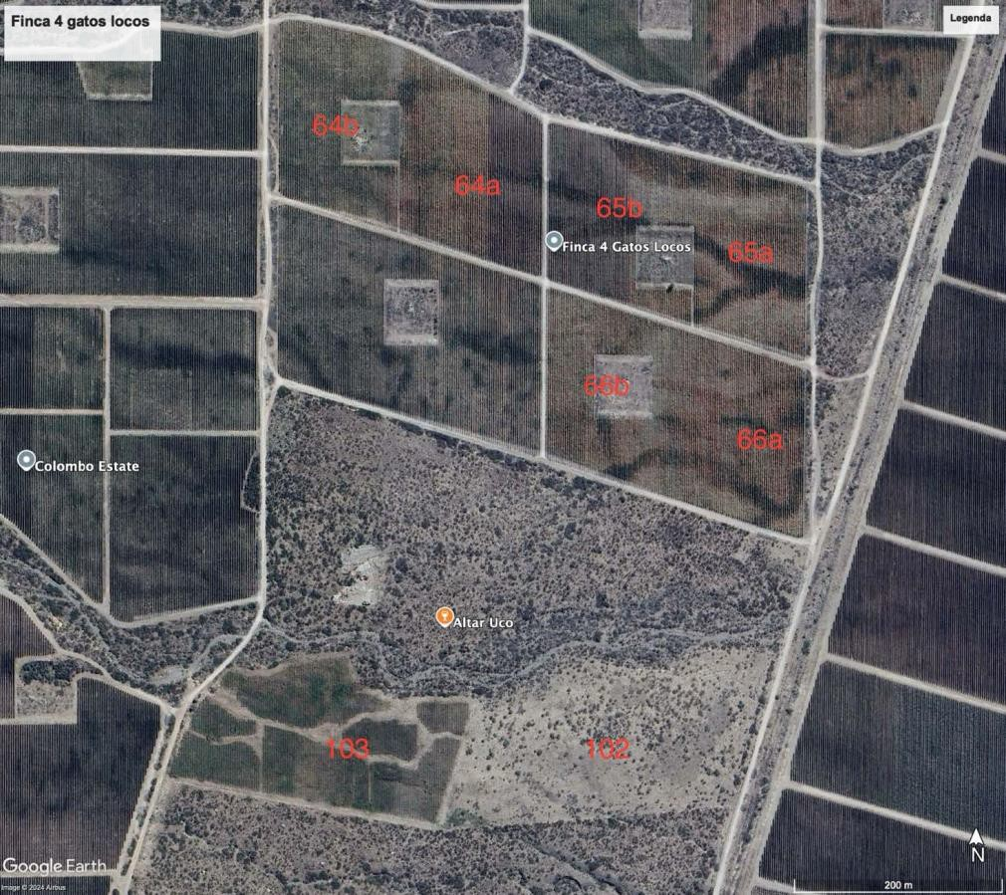
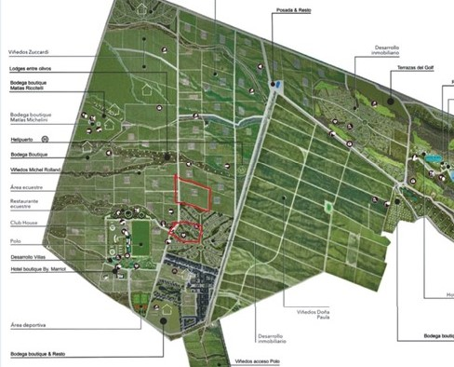
Property Overview
3
Total property: 5 plots
On The Offer Plots 66 and 103
Location Details

Slide 4
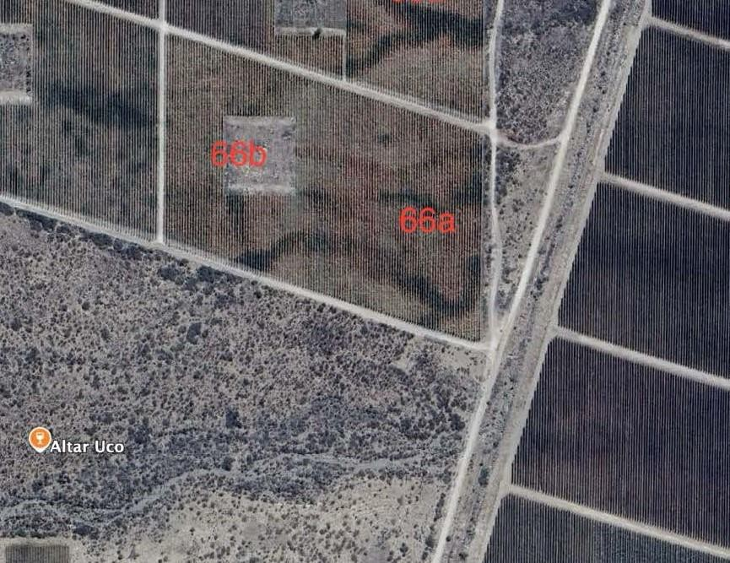
Plot 66 Details
4
Size: 4.090915 hectares
Planted: 2009
Variety: Malbec on 1103 Paulsen rootstock
Certified Organic
Subdivided into sections a and b
Reserved space in 66b for house/winery (3000 sq meters)
- Price: $425,000

Slide 5
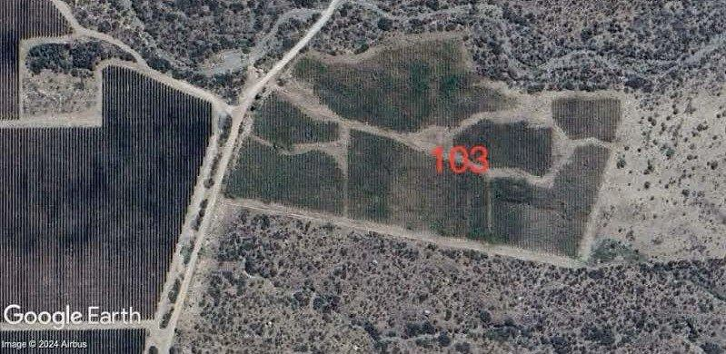
Plot 103 Details
5
Size: 4.616336 hectares
Planted: 2021
Varieties: Mixed (Cabernet Franc, Grenache)
Certified Organic
2.9 ha with basic vineyard structure and irrigation
Opportunity for replanting
- Price: $325,000

Slide 6

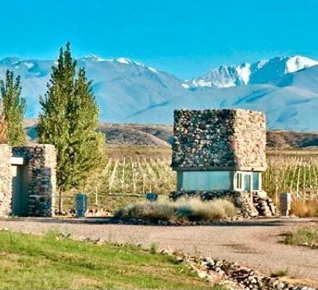
6
Vineyards@bbiargentina.com
+1 (416) 937-1153
BOOK A ZOOM CALL

